Slide 1

HOSPITAL MANAGEMENT
PROJECT SHOWCASE

Slide 2
0.
OVERVIEW
Because I’m a computer scientist.
THE OUTLINE.

Slide 3
OUTLINE
DESCRIPTION.
FEATURES.
WORK PROCESS.
CHALLENGES.
FUTURE PLAN.

Slide 4
1.
PROJECT DESCRIPTION
THE MAIN IDEAS.

Slide 5
DESCRIPTION
HOSPITAL MANAGING PROBLEMS.
WHY HOSPITAL MANAGEMENT?
WHAT IS HOSPITAL MANAGEMENT?
📖
📖
📖
Managing informations.
Ease of use for patient.
Communication system.
Admitting and releasing patient.

Slide 6
2.
FEATURES.
THE IDEAS.

Slide 7
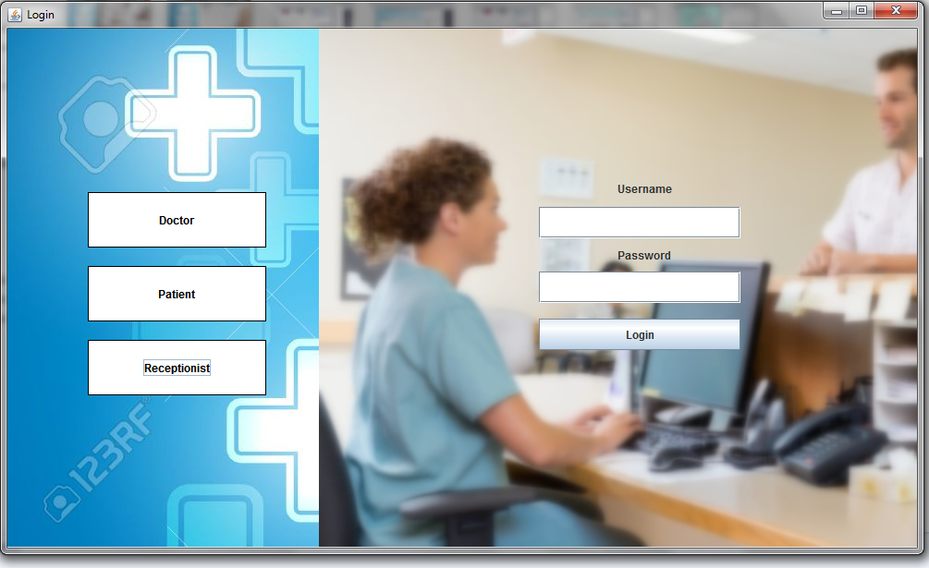
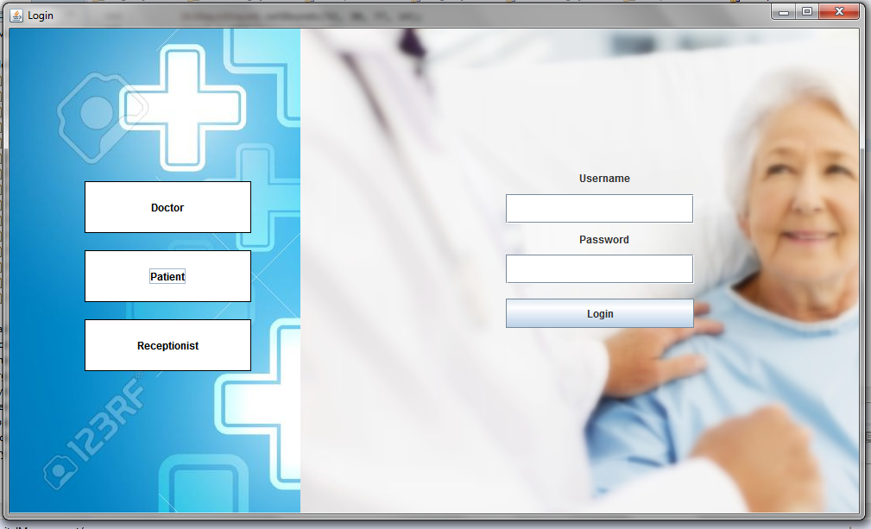
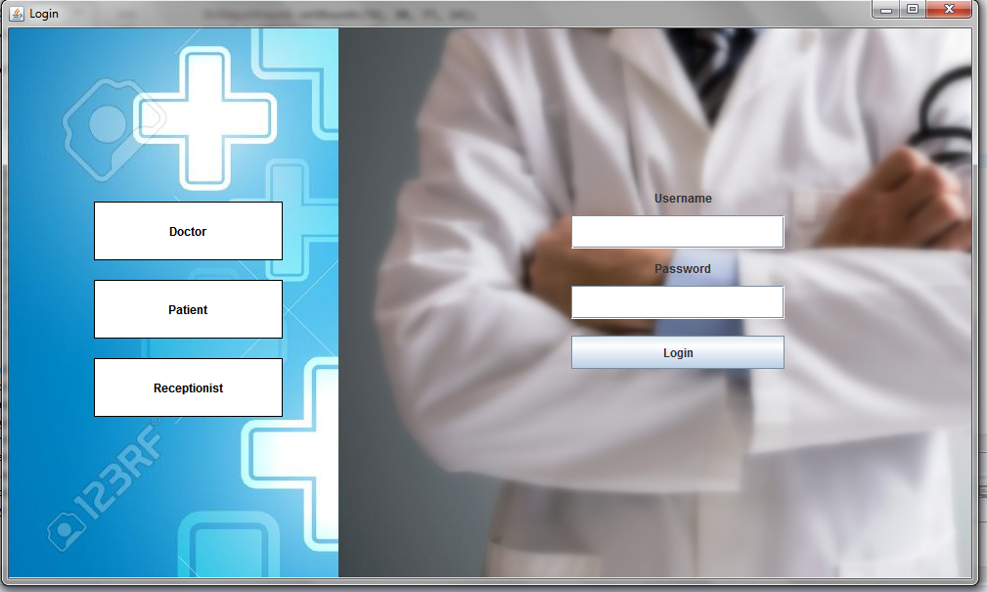
DOCTOR, PATIENT, RECEPTIONIST LOGIN
3 Individual Login System.
Different Database tables.
Flat buttons on login page.
Doctor, Patient, Receptionsts has different panels

Slide 8
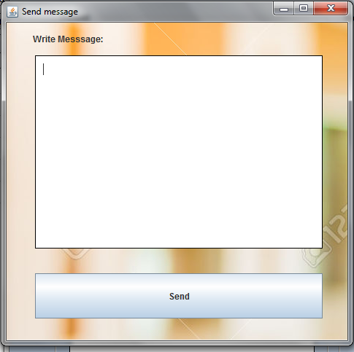
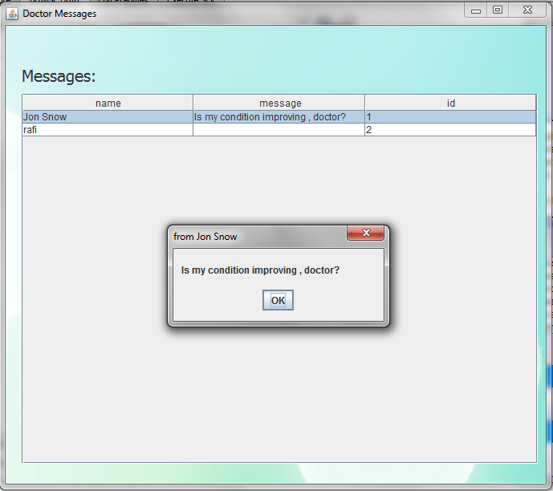
MESSAGING FEATURE:
For Condition update.
Doctors can see messages.
Inbox System.
Patient and Receptionsts can send messages.

Slide 9
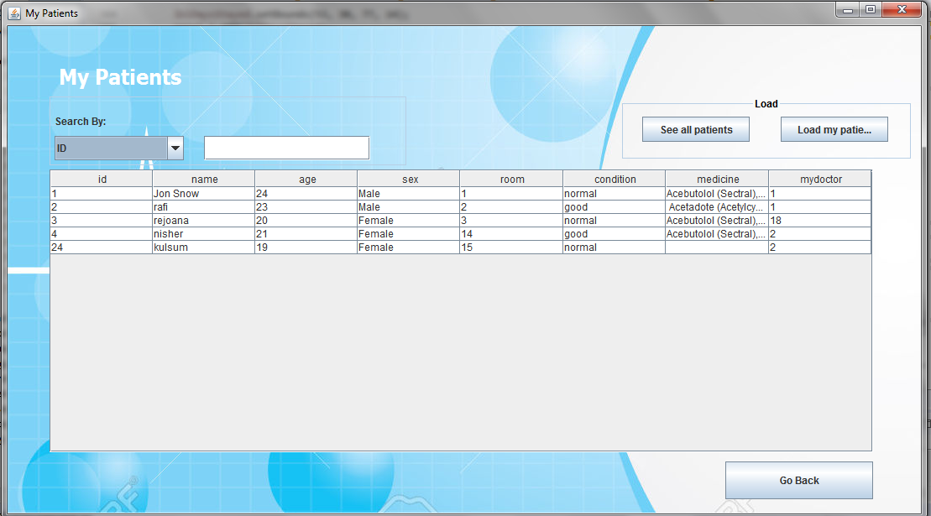
DOCTOR’S MY PATIENT LIST:
All patients showcase.
Load specific patients.
Instant search.
Search by id, name age etc.

Slide 10
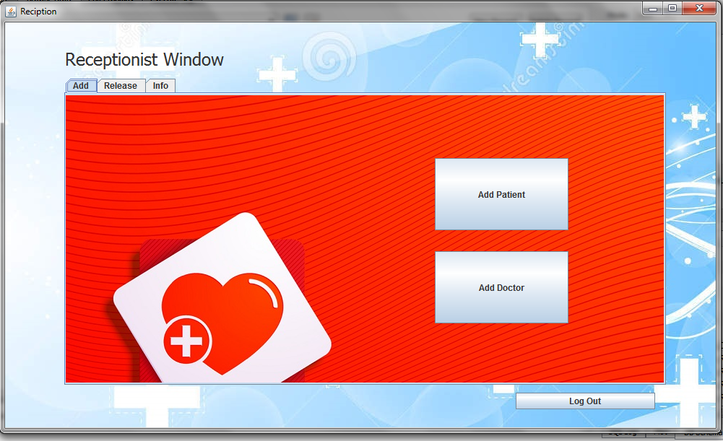
RECEPTIONIST WINDOW:
Reciptionist window.
Tab option.
Add doctor and patient.
Release patient.
Information.

Slide 11
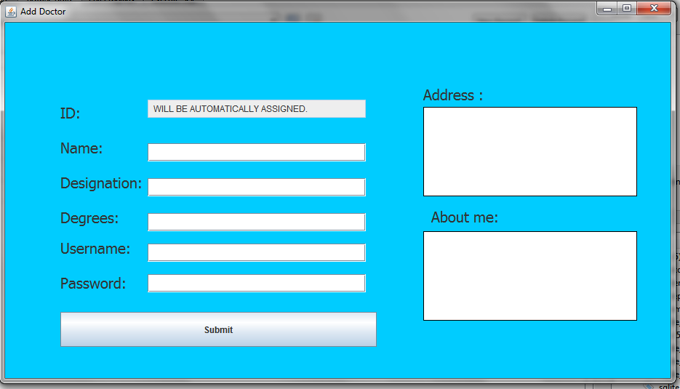
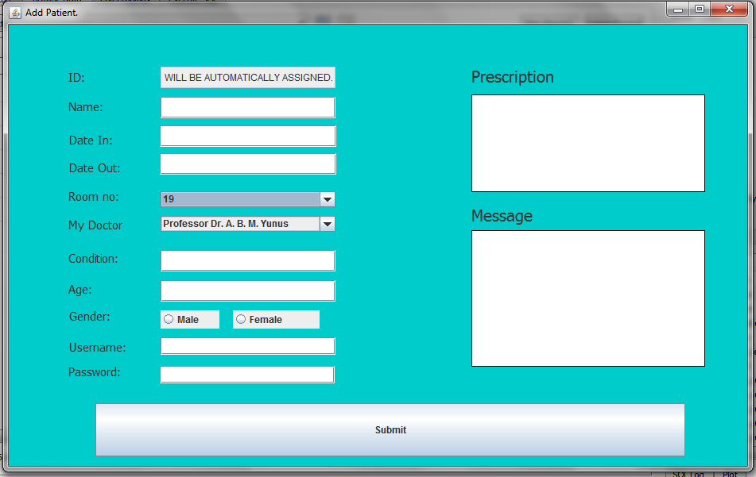
ADDING NEW PATIENT AND DOCTOR:
ADD PATIENT
ADD DOCTOR

Slide 12
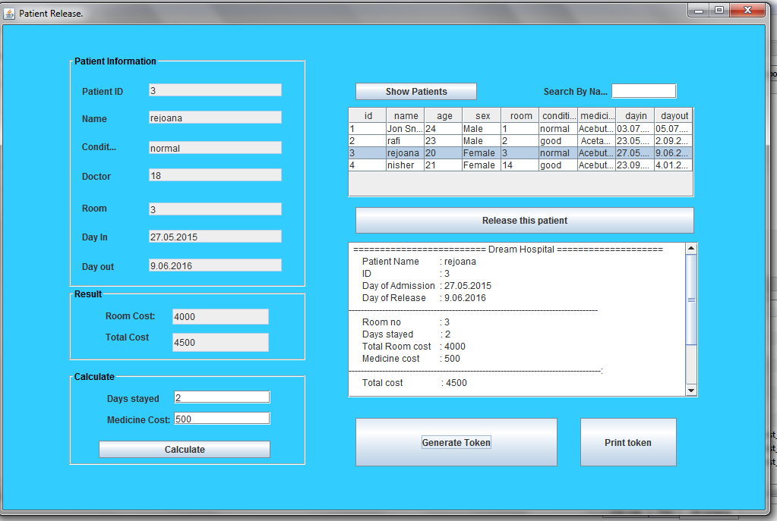
RELEASING PATIENT
Search patient.
Select relasing patient.
Calculate total cost.
Release slip.
Print and Release patient.

Slide 13
3.
PROCESS.
jhondipto@gmail.com
THE WROK FLOW.

Slide 14
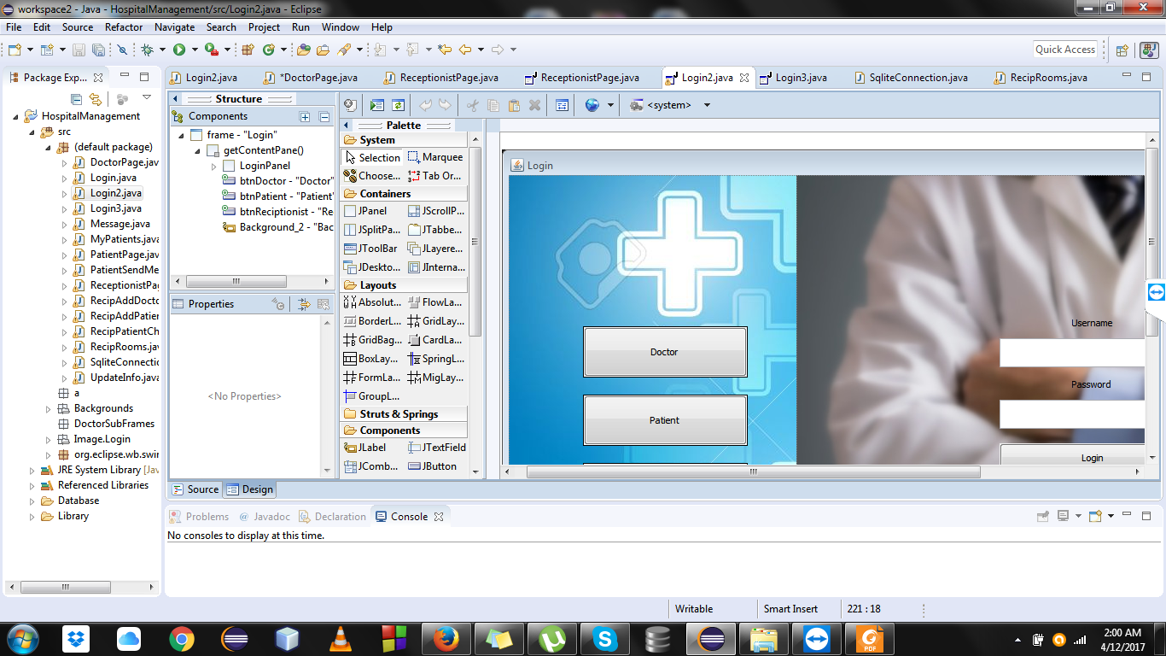
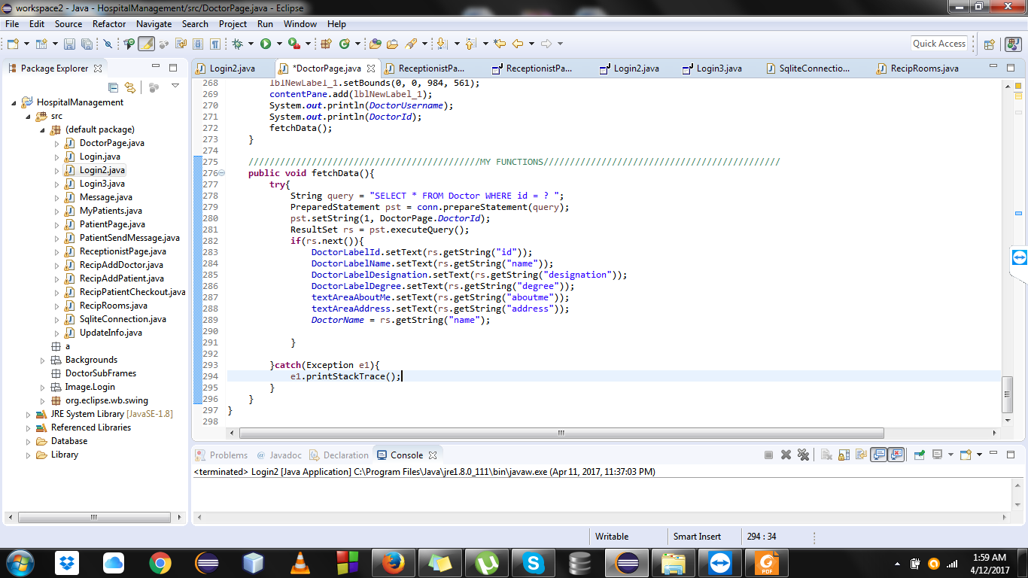
SOFTWARES:
IDE: ECLIPSE.
ROBUST.
LOTS OF FEATURES.
CUSTOMIZABLE.
GUI EDITOR: WINDOW BUILDER.
FLEXIBLE.
EASY TO USE.

Slide 15
4.
CHALLANGES.
jhondipto@gmail.com
the obstacles I faced.

Slide 16

Challanges
Database was blocked.
Action Listeners can’t write variables.
Closing window properly.
Deleting, Updating, Inserting into the database.
Tabs, Combo box, Radio Button etc. implementation.
Fixing little bugs.

Slide 17
5.
FUTURE PLAN.
the work flow.

Slide 18

FUTURE PLAN.
SEND EMAIL TO DOCTOR.
SECRET ADMIN PANEL.
DATE AND TIME OPTION.
DIGITAL CLOCK ADDING.
CALCULATOR OPTION.
HOSPITAL STATUS.

Slide 19
THANKS!
😉
Any questions?

